Slide 1
Category review: Chips
June 2020
Retail Analytics
Brand note: If client logo is not required, use alternate title page layout right click slide thumbnail > Layout > Title

Slide 2
Notes:
To view Privacy video explaining how important data privacy is to Quantium, please click here: https://www.youtube.com/watch?v=Zq1QDAkoRzU
or here Q:\Company Reference\Brand & Design\Brand videos\Q Privacy.mp4
At Quantium, we believe that data is the behavioural footprint of humanity and that it has to be treated with the utmost care and responsibility.
Histories, attitudes, indeed lives are stored within it in ways that aren’t always apparent – and that’s what makes its potential so powerful.
To work with it responsibly, sensitively, we set ourselves the highest data privacy protection and governance standards.
We have spent 17 years perfecting privacy-by-design and secure-by-design principles. Central to this is not holding any personally identifiable information about people –
we neither receive it, and put the necessary protections in place to be unable to decipher it.
Every aspect of handling data is safeguarded: from its de-identification, to its encryption – data security is paramount and of the highest grade.
We pride ourselves on gaining the trust of iconic organisations around the world through years of securely working with their data,
and in turn the trust that builds with their stakeholders.

Slide 3
Executive summary
01
Task 1
Here you will include your high-level findings and any key callouts for task 1
Sales have mainly been due to Budget - older families, Mainstream - young singles/couples, and Mainstream - retiree's shoppers.
The high spend on chips for mainstream young singles/couples and retirees is due to number of them is greater than other buyers.
Mainstream, mid-age, and young singles and couples are also more likely to pay more per packet of chips. This is indicative of impulse buying behavior.
Mainstream young singles and couples are 23% more likely to purchase Tyrrells chips compared to the rest of the population.
02
Task 2
Here you will include your high-level findings and any key callouts for task 2
The results for trial stores 77 and 88 during the trial period show a significant difference in at least two of the three trial months, but this is not the case for trial store 86.
We can check with the client if the implementation of the trial was different in trial store 86, but overall, the trial shows a significant increase in sales.

Slide 4
01
Category

Slide 5
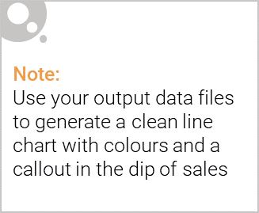
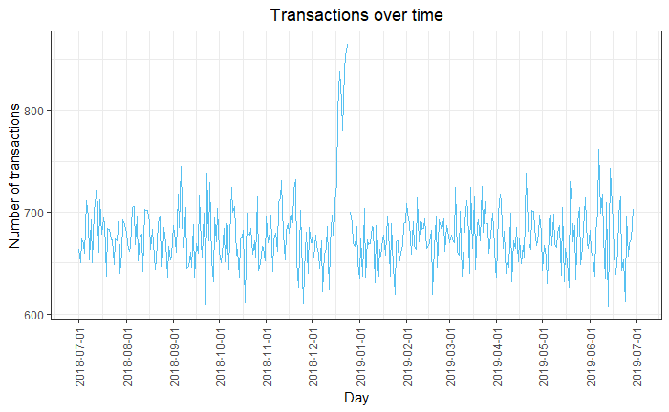
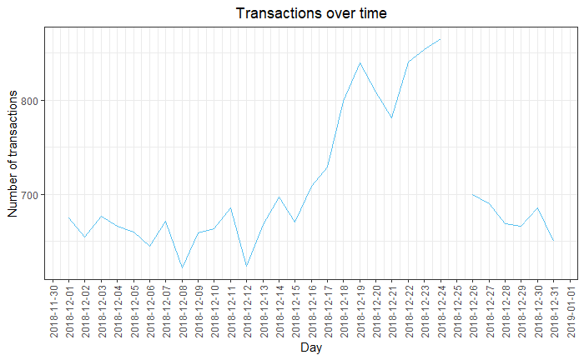
Overview: your key callout for the category should be included here

Slide 6

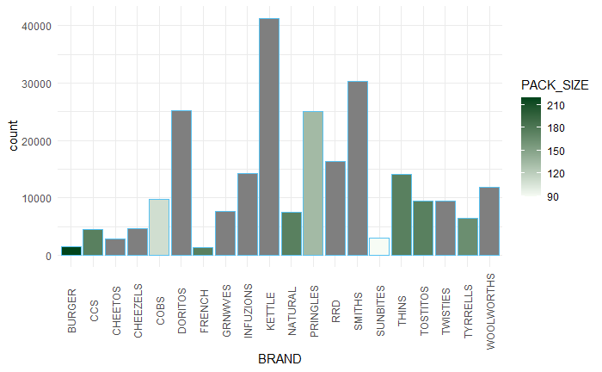
This slide will be commentary on affluence and its effect on consumer buying for the category of chips

Slide 7
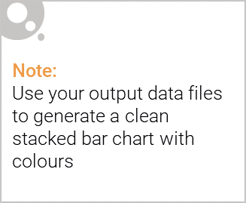
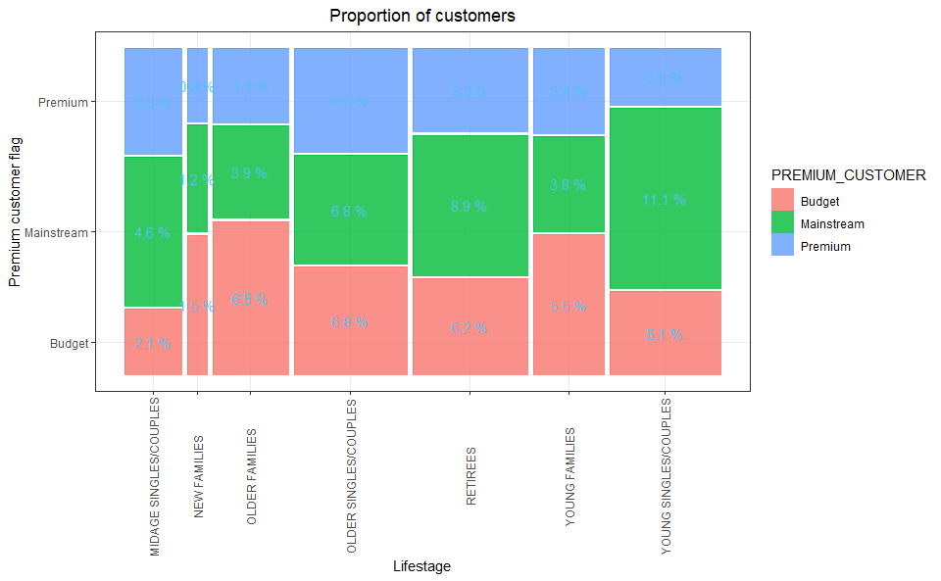
Editable (delete this)
Stretch: Try visualising the proportion of customers by affluence and life stage on this slide

Slide 8
02
Trial store performance

Slide 9
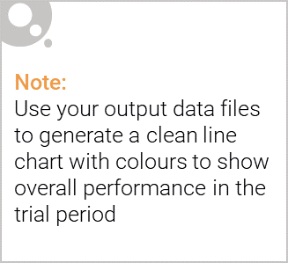
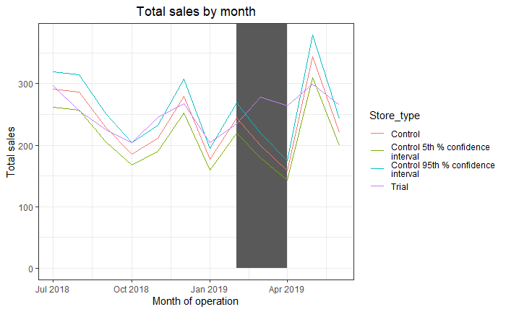
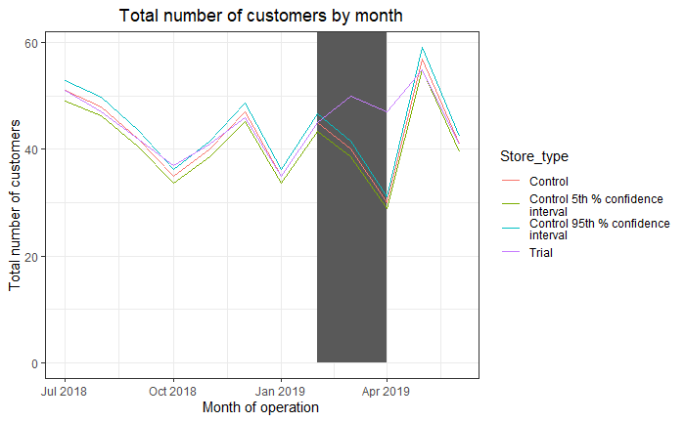
Explanation of the control store vs other stores

Slide 10
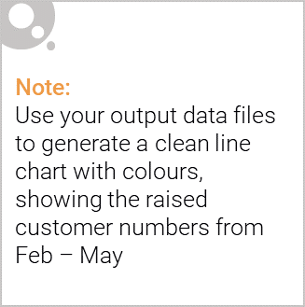
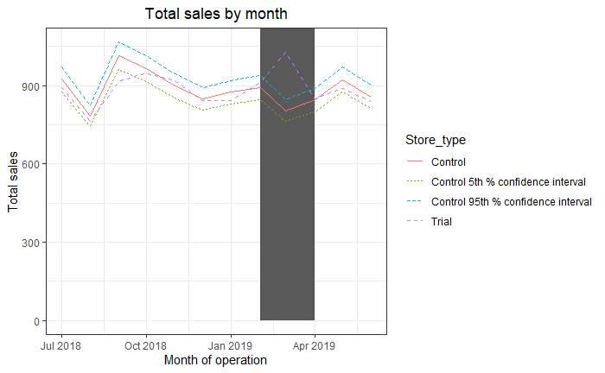
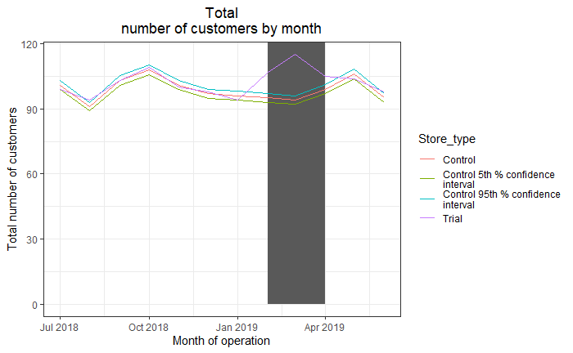
Call out of the performance in the trial store, determining if it was successful

